Slide 1
A Conflict-free Branch and Bound Approach for Scheduling AGVs
Advisor Professor: Hassan Rashidi
Amirreza Taghizadeh
Student Number: 400131410008

Slide 2
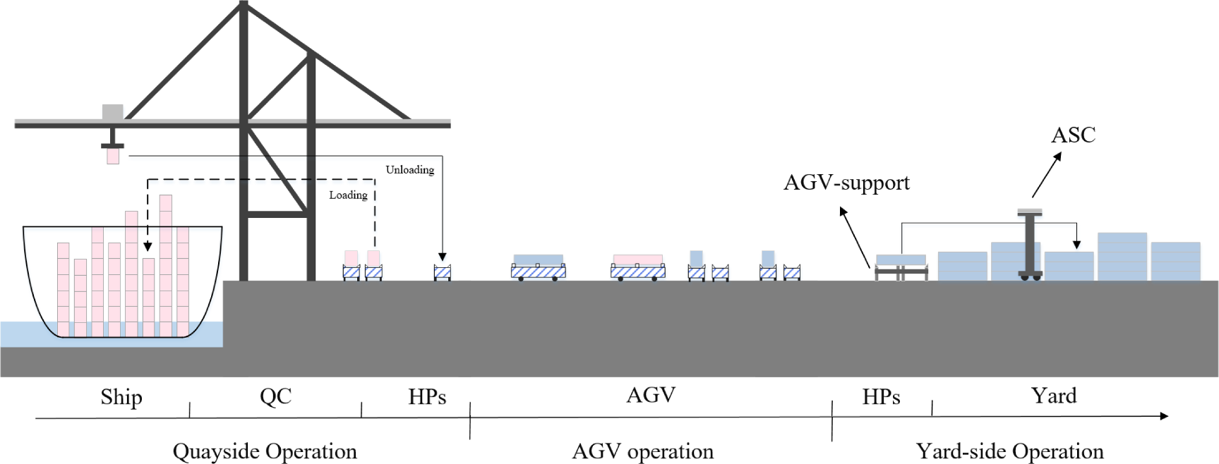
Introduction: Problem statement

Slide 3
Literature Review: NSA
Model Properties: 1. objective function 2. constraints
Path Topology:
Advantages of it
Disadvantages of it regard to our problem

Slide 4
Literature review: Dynamic NSA (DNSA)
Model Properties: 1. objective function 2. constraints
Path Topology:
Advantages of it
Disadvantages of it regard to our problem

Slide 5
Literature Review: Yang Genetic Algorithm 2018
Bi-level genetic algorithm
Path topology
Advantages
Disadvantages

Slide 6
Integrated Scheduling of Vehicles, considering Conflict
Model Review: Search method is based on genetic algorithm
Path Topology:
Advantages:
Disadvantages: Simple one-way paths

Slide 7
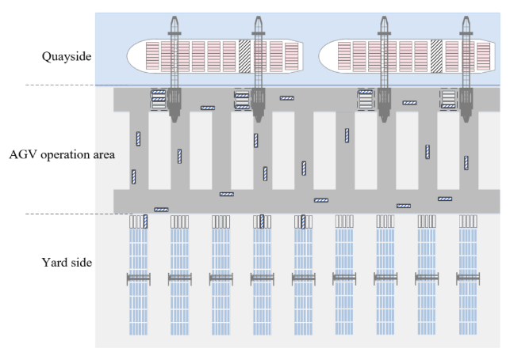
Proposed Approach
The Model and its Symbols and parameters:
Terminal Layout:
Path Topology

Slide 8
Model Formulation
Objective function
More rigorous formulation of Constraints

Slide 9
Proposed Algorithm for solving the MIP: Branch and Bound
Formal intuition for branch and bound algorithm (in terms of relaxation to LP)
Time complexity of Branch and bound
The searching and heuristics for finding upper and lower bounds of the solution
The tree search and pruning

Slide 10
The Implementation: GAMS and XPRESS
Why GAMS (C++ API) as the modeling language:
Generalized language (with API for python, C++, matlab, etc
Xpress as the solver for the smaller MIP model
One of the fastest MIP Solvers

Slide 11
How to compare the results: Rashidi & Habibi Genetic Approach
Though not considering conflict and high possibility of failure!

